Slide 1
Greatness in the Kingdom
Kingdom Character
(Matt 5:1-12)
Kingdom
Calling
(Matt 5:13-16)
Kingdom Conduct
(Matt 5:17-7:27)

Slide 2
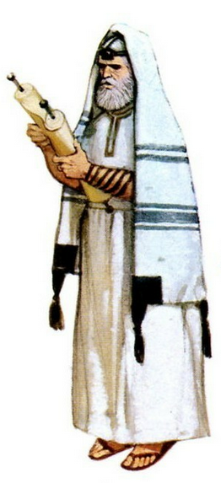
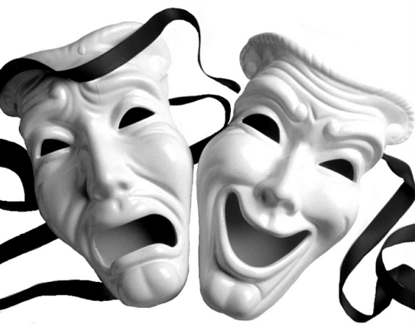
Greatness in the Kingdom
… must
surpass
that of the Scribes and Pharisees …
(Matthew 5:20)
… not as the hypocrites do ...
(Matthew 6:1-2)
Righteousness Warnings

Slide 3
Greatness in the Kingdom
In the same way, let your light shine before others, so that they
may see your
good works
(Matt 5:16)
Beware of practicing your righteousness before other people in order to be
seen by them
(Matt 6:1)
Righteousness Warnings

Slide 4
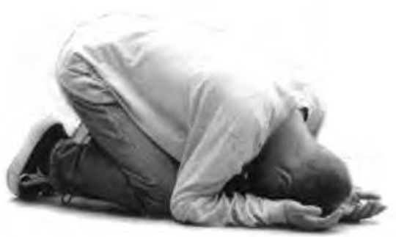
Greatness in the Kingdom
Whose?
the Father’s?
the world’s?
Righteousness Warnings

Slide 5
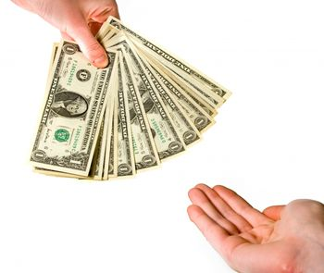
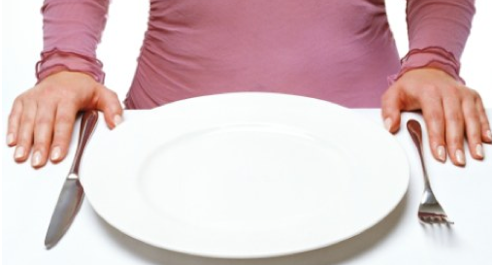
Greatness in the Kingdom
… this has implications for how we …
… give …
(Matt. 6:2-4)
… pray …
(Matt. 6:5-15)
… fast …
(Matt. 6:16-18)
Righteousness Warnings

Slide 6
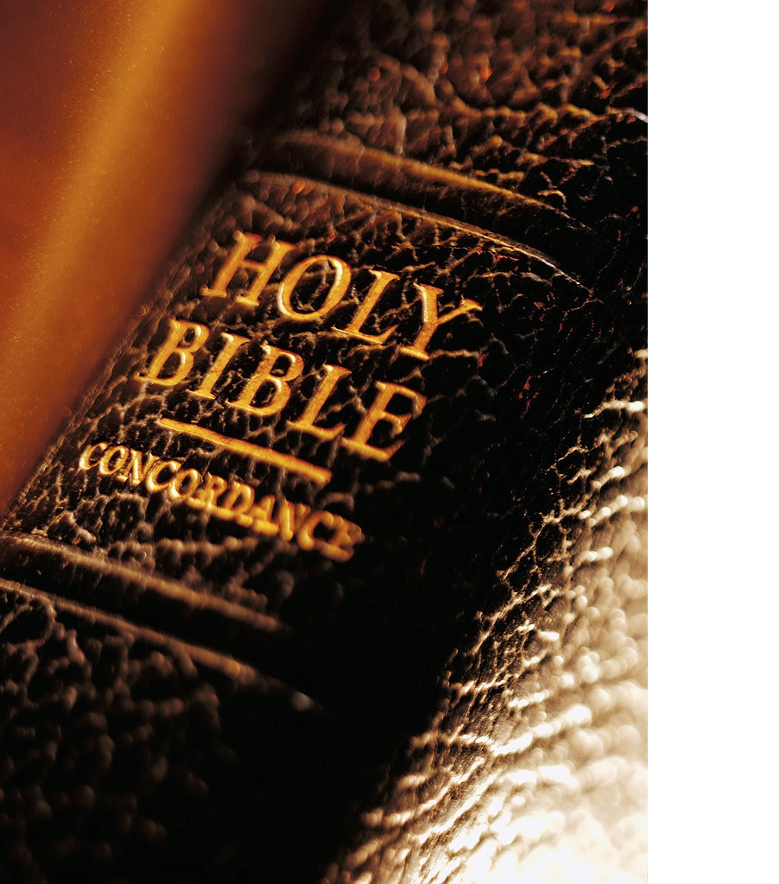
Matthew 6:1-2, 5, 16-18 (NLT)
¹ “Watch out! Don’t do your good deeds publicly, to be admired by others, for you will lose the reward from your Father in heaven. ² When you give to someone in need, don’t do as the hypocrites do—blowing trumpets in the synagogues and streets to call attention to their acts of charity! I tell you the truth, they have received all the reward they will ever get.

Slide 7
Matthew 6:1-2, 5, 16-18 (NLT)
⁵ “When you pray, don’t be like the hypocrites who love to pray publicly on street corners and in the synagogues where everyone can see them. I tell you the truth, that is all the reward they will ever get.
¹⁶ “And when you fast, don’t make it obvious, as the hypocrites do, for they try to look miserable and dishevelled so people will admire them for their fasting. I tell you the truth, that is the only reward they will ever get.

Slide 8
Matthew 6:1-2, 5, 16-18 (NLT)
¹⁷ But when you fast, comb your hair and wash your face. ¹⁸ Then no one will notice that you are fasting, except your Father, who knows what you do in private. And your Father, who sees everything, will reward you.

Slide 9
Greatness in the Kingdom
Few Western Christians fast
Jesus fasted (Matt 4:1)
Early Church fasted (Acts 9:9, 13:2, 14:23)
Church History: John Wesley, George Whitefield
When you fast …
(Matt 6:16, 17)

Slide 10
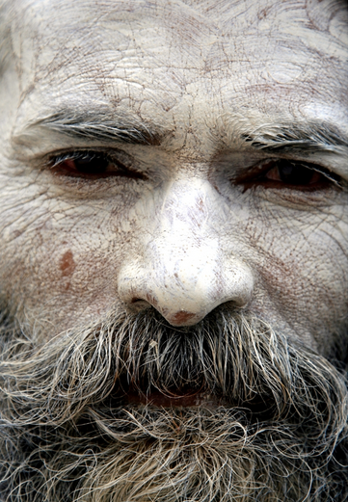
Greatness in the Kingdom
Only required on Day of Atonement (Lev 16:31)
Pharisees fasted two days each week (Mon/Thu)
Looked miserable (Matt 6:16)
Don’t make it obvious, as the hypocrites do
(Matt 6:16)

Slide 11
Greatness in the Kingdom
Not a requirement to look unusually glamorous!
Business as usual (Matt 6:17)
Fraff: fasting is a sign of deep spirituality
… comb your hair and wash your face.
(Matt 6:17)

Slide 12
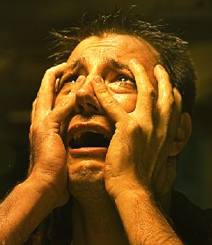
Greatness in the Kingdom
Fasting & Repentance
Purification (Lev 16:31)
Weep/mourn (Joel 2:12)
Confession (Neh 9:3)
Fasting is rewarded by the Father
(Matt 6:18)

Slide 13
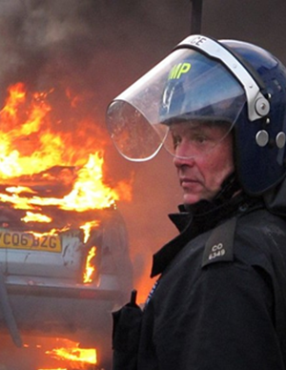
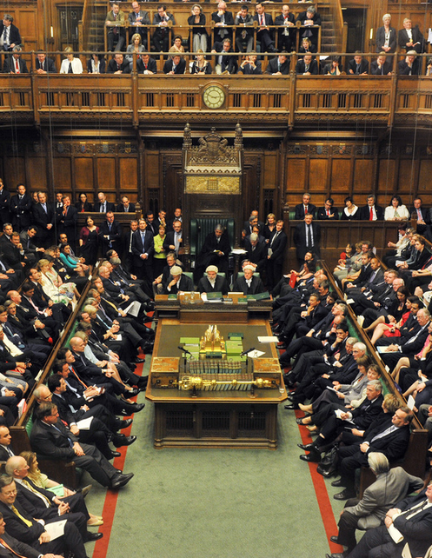
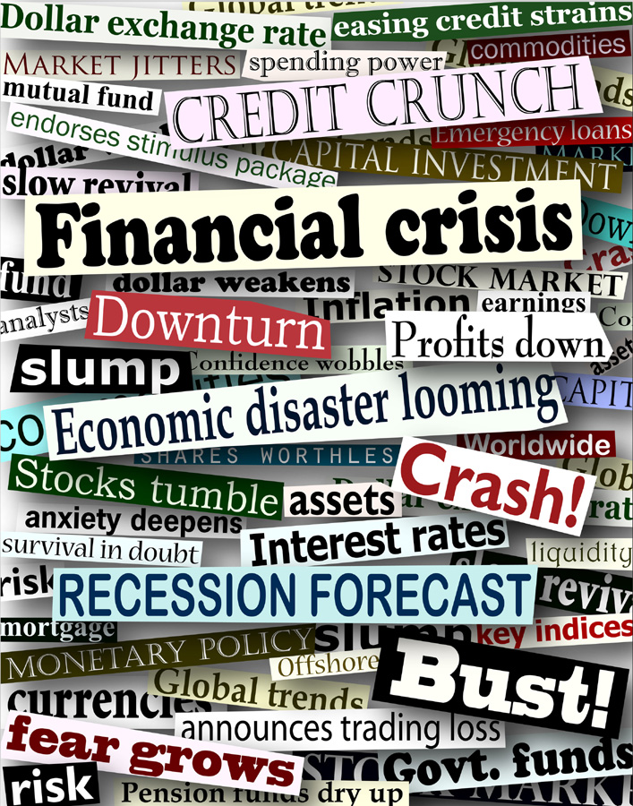
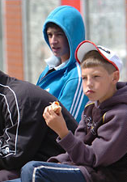
Greatness in the Kingdom
National Crisis
Destruction (Neh 1:4)
Genocide (Esth 4:3)
Invasion (2 Chron 20:1)
Fasting is rewarded by the Father
(Matt 6:18)

Slide 14
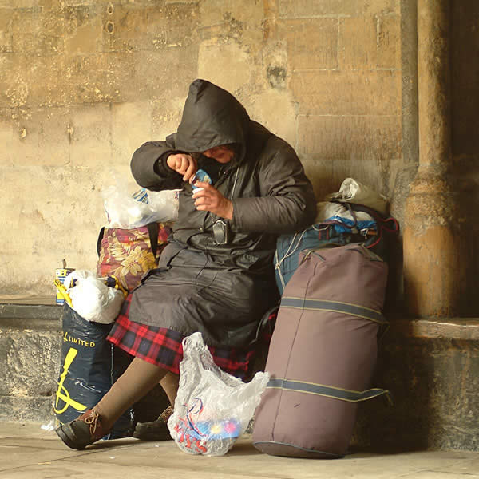
Greatness in the Kingdom
Social Justice
True fasting (Isa 58:5-12)
“this is the kind of fasting I want:
free oppressed
lighten burdens
break chains
feed the hungry
house the homeless
clothe the naked
help your family
v
v
v
v
v
v
v
Fasting is rewarded by the Father
(Matt 6:18)

Slide 15
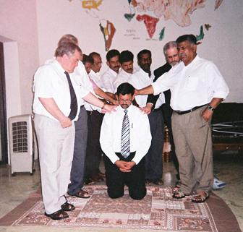
Greatness in the Kingdom
Church Vision/Purpose
Saul/Paul (Acts 9:9)
Missions (Acts 13:1)
Elders (Acts 14:23)
Fasting is rewarded by the Father
(Matt 6:18)

Slide 16
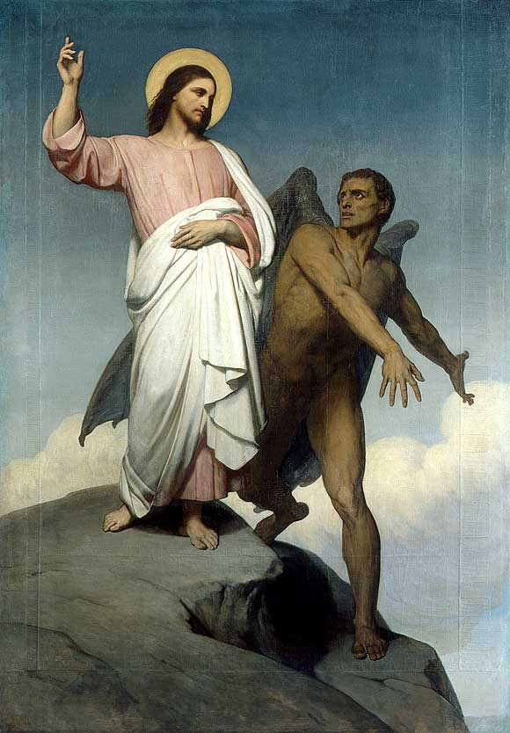
Greatness in the Kingdom
Spiritual Warfare
Jesus (Luke 4:2)
Disciples (Mark 9:29?)
Then Jesus returned to Galilee, filled with the
Holy Spirit’s power. (Luke 4:13-14)
Fasting is rewarded by the Father
(Matt 6:18)

Slide 17
Greatness in the Kingdom
is it time to recover a
is it time to recover a
vital discipline?
vital discipline?
God’s mercy on this nation?
Revival for
the Church?
God’s kingdom in our community?
Fasting is rewarded by the Father
(Matt 6:18)

